Slide 1
Bacterial skin infections
Dr. Indira Kahawita
Consultant Dermatologist
BH Homagama
25th Original

Slide 2
Bacterial infections
Impetigo
Cellulitis/ erysepelas
Necrotizing skin and soft tissue infections
Folliculitis
Sycosis barbae
Staphylococcal scalded skin syndrome (SSSS)
Pseudomonas infections
Furuncles/ carbuncles/abscesses
Mycobacterial infections
Leprosy

Slide 3
Impetigo
Superficial infection due to Staphylococci/ Streptococci
Bullous impetigo: Staphyloccus
Non bullous impetigo: Staphyloccus/ Streptococcus
Usually in face of children
Usually seasonal
Staphylococcal colonization of the nose or skin folds may play a role in recurrent impetigo
Post Streptococcal glomerulonephritis or serious secondary infections may follow impetigo

Slide 4
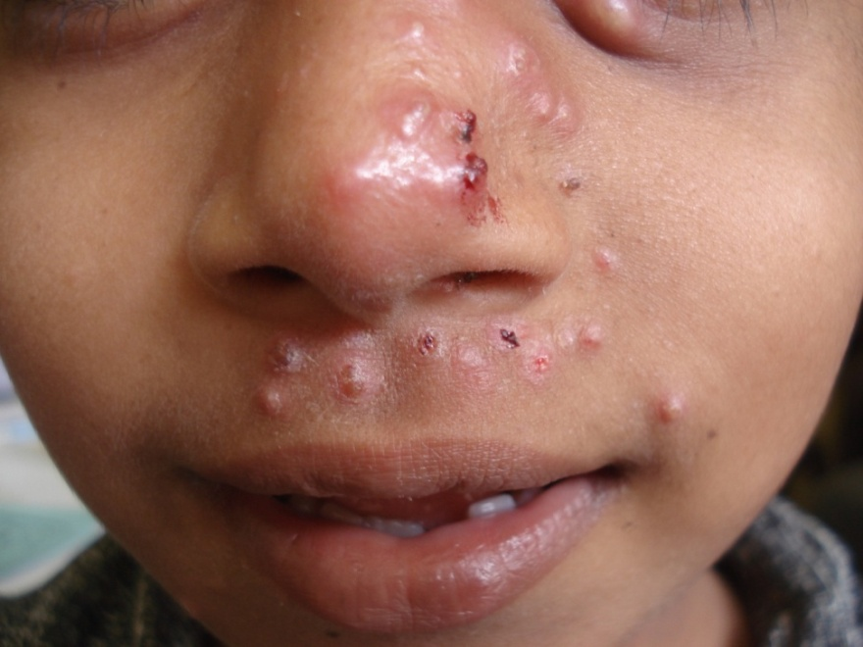
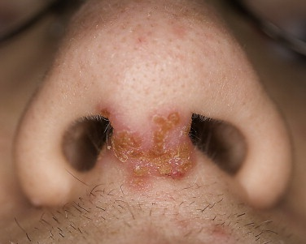
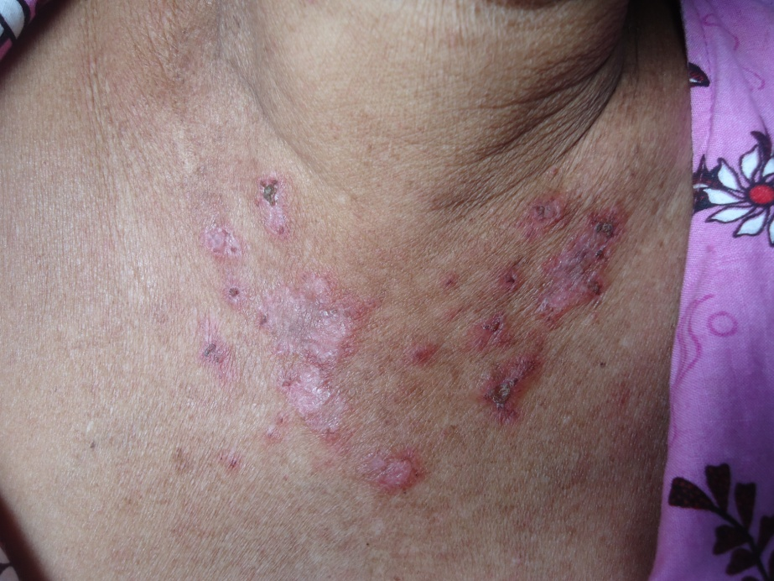
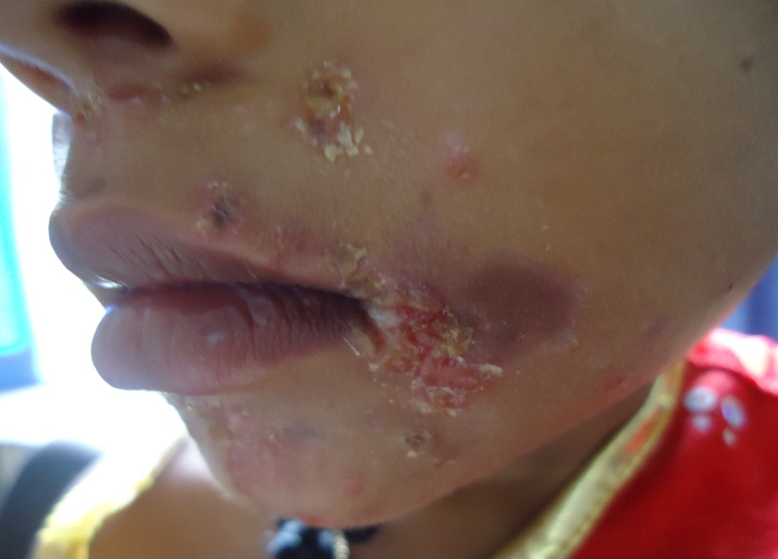

Slide 5
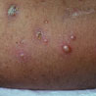
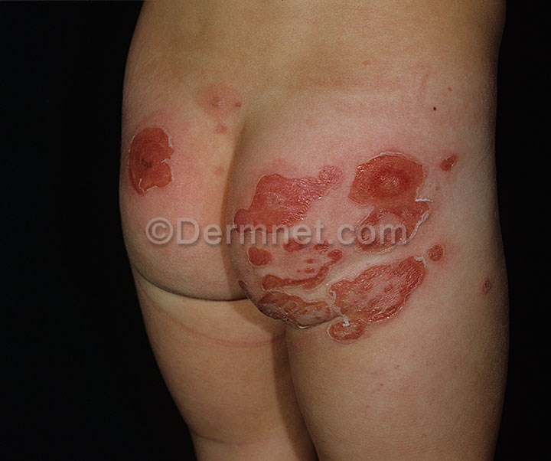
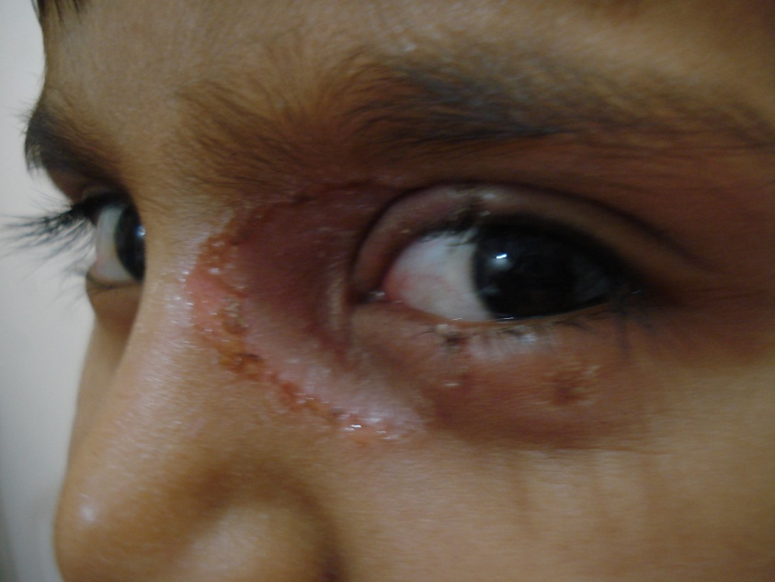
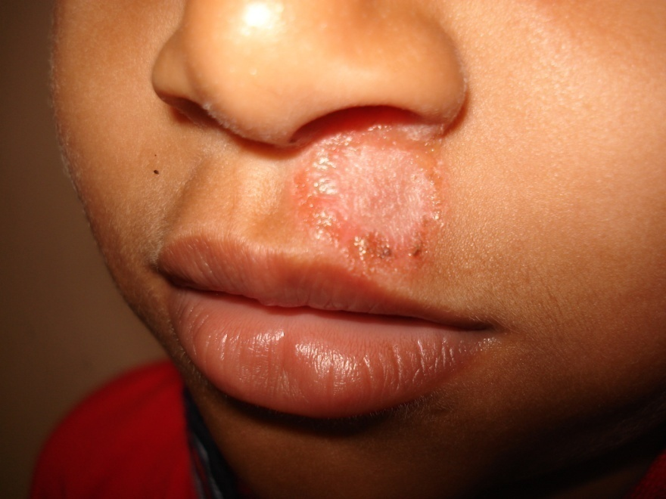

Slide 6
Treatment of impetigo
Topical treatment with Mupirocin ointment or Fusidic acid cream
Oral antibiotics
Cloxacillin
Flucloxacillin
Erythromycin
Amoxicillin-Clavulanate
Decolonization of nostrils with mupirocin ointment may be useful in recurrent impetigo

Slide 7
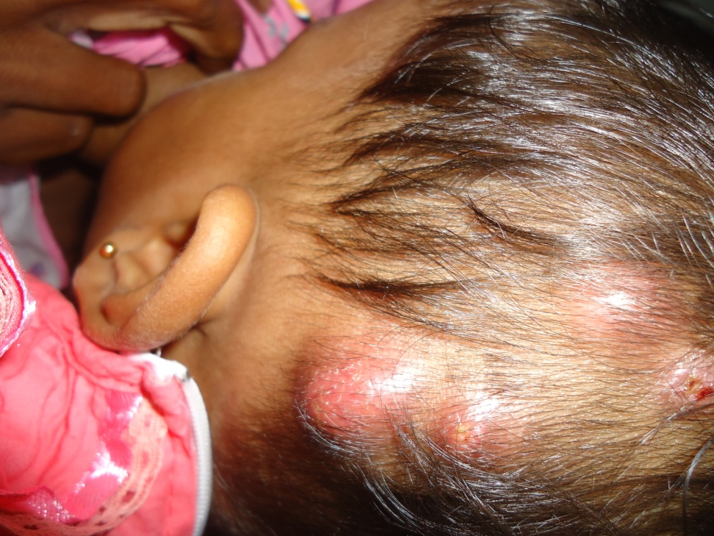
Folliculitis
Staphylococcal folliculitis is the commonest
Acute lesions may occur following minor injury, abrasion or topical steroid therapy
Scalp and other hair bearing regions are the commonest sites

Slide 8
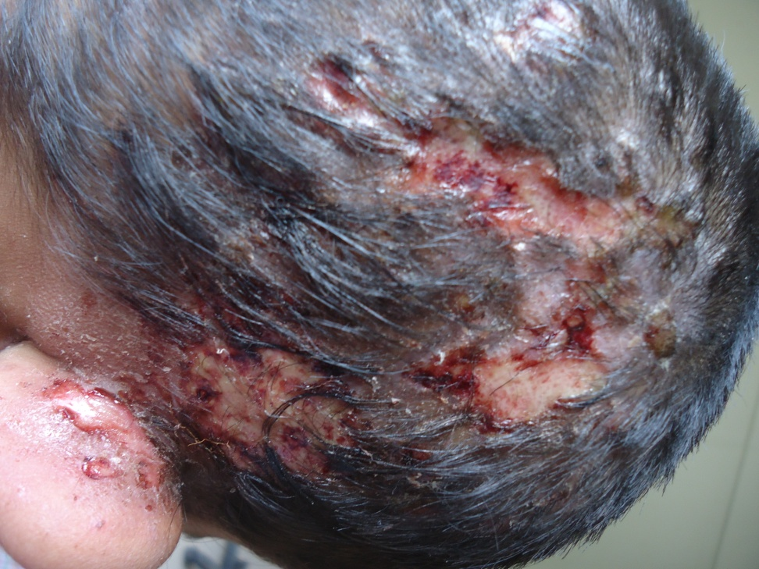
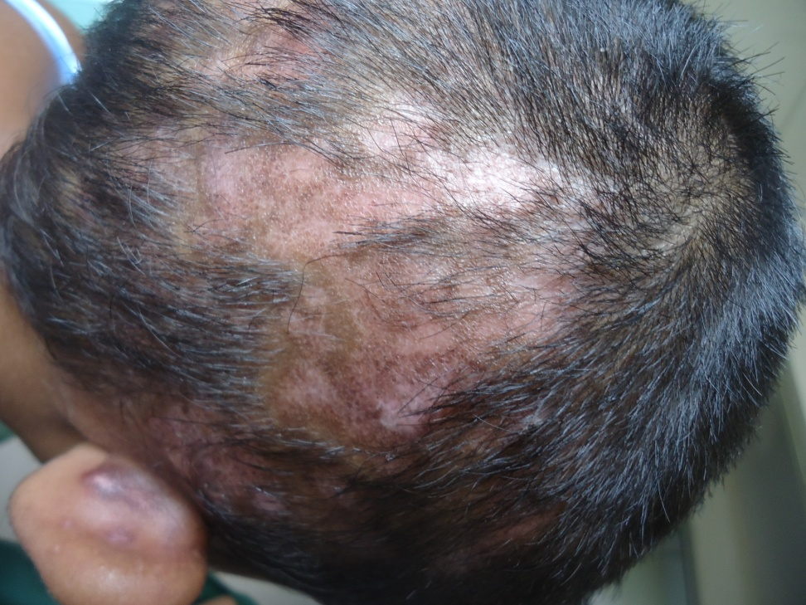
Scalp folliculitis may lead to alopecia

Slide 9
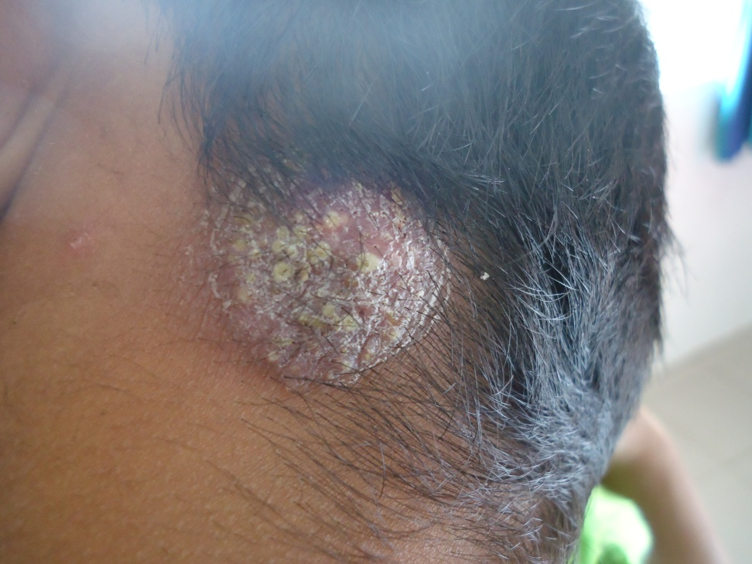
Scalp folliculitis must be differentiated from kerion
Folliculitis
Kerion

Slide 10
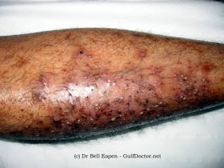
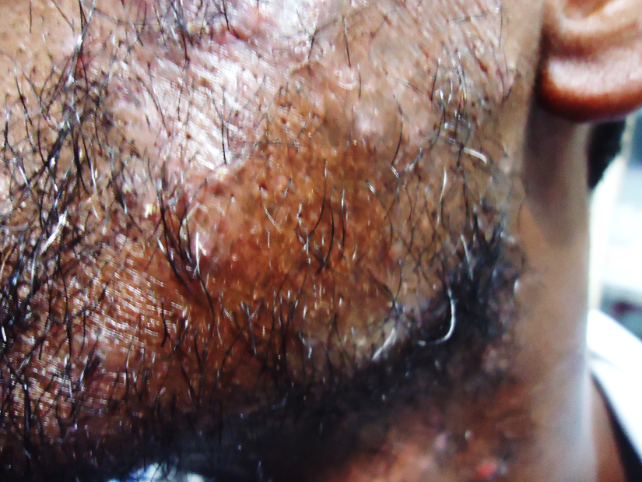
Chronic folliculitis
Chronic, bothersome condition
Legs are the commonest site, but may extend to any hair bearing area
Lead to scarring
May be precipitated by external material like oils/ grease

Slide 11
Management
Acute folliculitis
Chronic folliculitis
Systemic antibiotics with anti Staphylococcal activity
Topical antibiotic creams like fusudis acid/ mupirocin
Antiseptics like cetrimide shampoo / hibitane
Long term treatment needed
Systemic antibiotics for acute infections
Antiseptics solutions
Combinations of topical steroids and antibiotics
Anti histamines to control itch

Slide 12
Furuncles and carbuncles
Furuncle (abscess)
A walled-off collection of pus that is a painful, firm or fluctuant mass
Self limited one/ few lesions or recurrent chronic disease
In areas of friction/ minor trauma
Lower half of the body more susceptible
Pathogens: S.aureus / E.coli/ P.aeruginosa/ Anaerobes

Slide 13
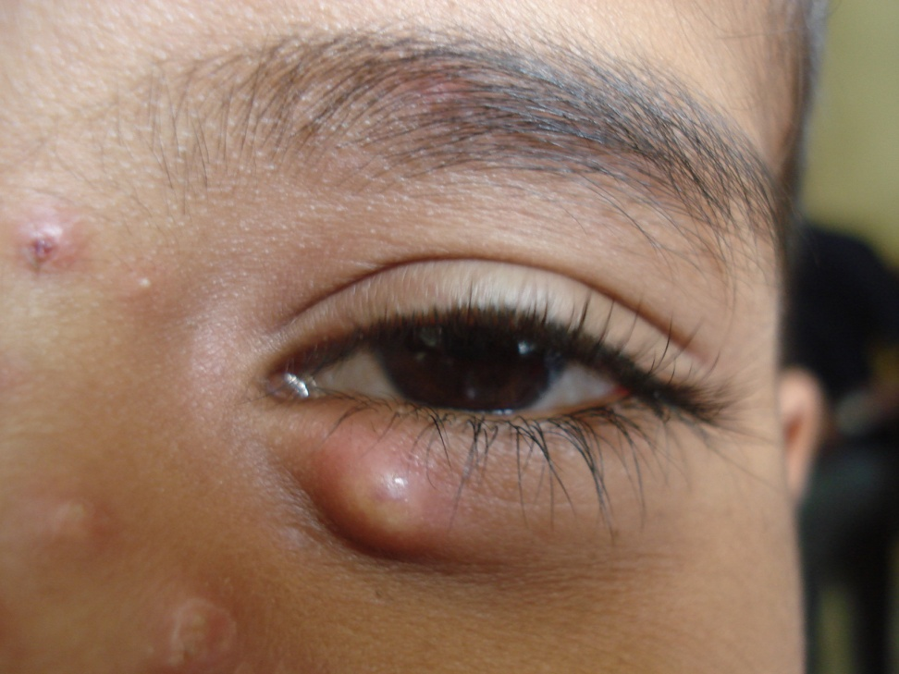
Furuncle
Evolution
Erythematous papule
Tender deep seated nodule
Painful fluctuant mass
Usually no systemic symptoms
May reabsorb/ rupture giving rise to large amounts of pus

Slide 14
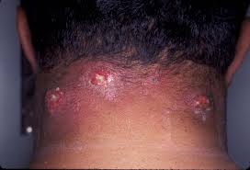
Carbuncle
Infection of aggregates of follicles
Deep dermis and subcutis
Associated systemic symptoms
Back of neck and trunk, lateral thighs

Slide 15
Treatment
Warm compress
Incision and drainage (only when overlying skin thin and abscess is fluctuant)
Anti Staphylococcal antibiotics
Bacteriological studies for nasal carriage in recurrent furunculosis

Slide 16
Skin infections due to Corynebacteria
Erythrasma
Trichomycosis axillaris
Pitted keratolysis

Slide 17
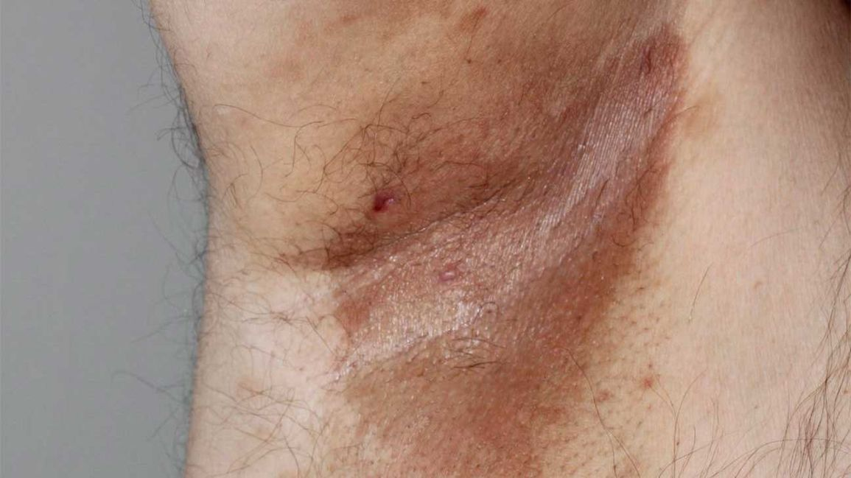
Erythrasma
Corynebacterium minutissimus
Flexural lesions
Well defined, brown, non inflammatory scaly patches
Treated with oral erythromycins and topical antifungals/ erythromycin

Slide 18
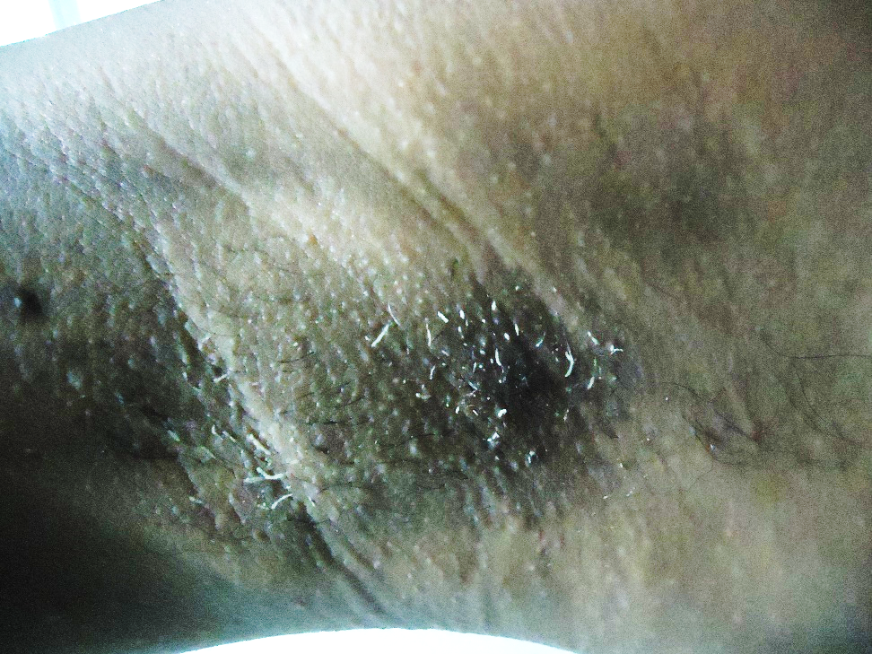
Trichomycosis axillaris
Due to bacterial action on the sweat
Body odour
Yellow concretions on the flexural hairs
Yellow staining of clothes
Treatment
Shaving of hairs
Oral and topical erythromycins
?anti perspirants

Slide 19
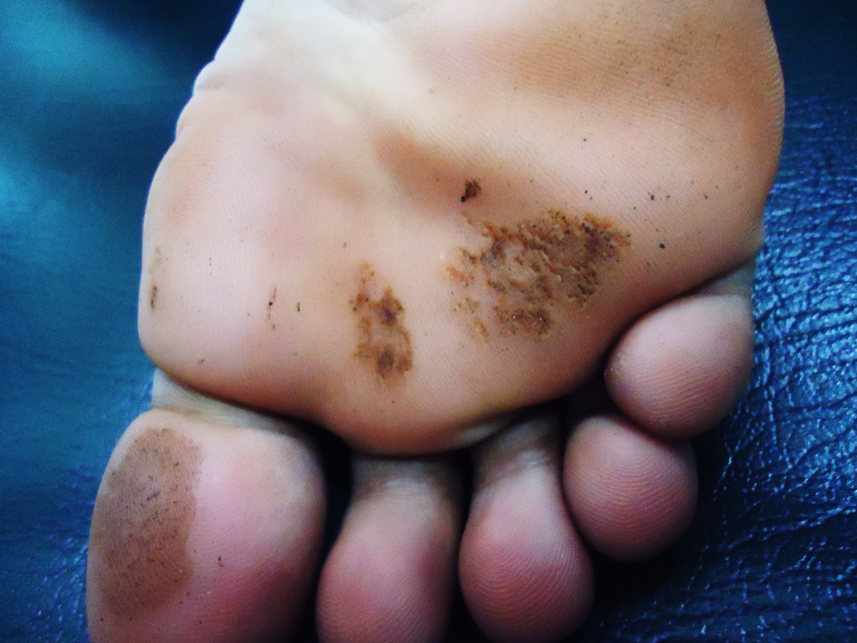
Pitted keratolysis
In persons with hyperhidrosis
Bacterial action on wet keratinized skin
Treated with
Topical antibiotics
Control of sweating

Slide 20
Pseudomonas skin infections
Pseudomonas are part of skin flora (anogenital, axillary and external auditory canal)
Characteristic odour and colour
Clinical presentations
Folliculitis
Toe web intertrigo
Cellulitis
External otitis
Ecthyma gangrenosum

Slide 21
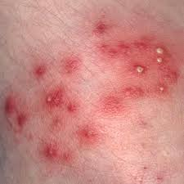
Pseudomonas folliculitis
Following contact with infected moist source (tub, loofah, whirlpool)
Pruritic, red plaques with papules and pustules
Usually resolve spontaneously
May be treated with white vinegar/ silver sulphadiazine

Slide 22
Otitis externa
Precipitated by excessive moisture and trauma
Cerumen offers a natural barrier against gram negative infection which is breached by moisture/ manipulation/ diseases
Pseudomonas is the commonest pathogen
Painful erythema, swelling of canal, discharge
Later involve pinna with pain and cellulitis
Managed with topical antibiotics (gentamicin), acidification with 2% acetic acid and systemis therapy with ciprofloxacin

Slide 23
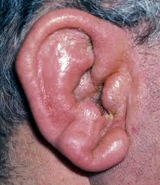

Slide 24
Toe web infection
May be misdiagnosed as tinea pedis
Usually in males with broad toes and tight interdigital spaces
Thick, white (with greenish tinge) maceration of web space with soggy wetness
Later develop purulent discharge
Denudation of skin spreads into plantar and dorsal surfaces of toes

Slide 25
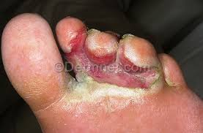
Toe web infection
Managemant
Debridemant of devitalized tissue
0.5% silver nitrate soaks/ 5% acetic acid
Gentamicin cream/ silver sulphadiazine cream (combination of clotrimazole and gentamicin is available)
Oral ciprofloxacin if severe
Measures to prevent re-infection

Slide 26
Ecthyma gangrenosum
Cutaneous manifestation of Pseudomonas septicaemia
In immunocompromised persons
Pathognomonic of Pesudomonas infection
High mortality rate
May occur without bacteremia
Need in-patient care with systemic antibiotics and supportive therapy

Slide 27
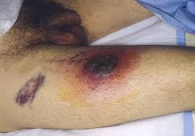
Ecthyma gangrenosum
Isolated, red purpuric macules
Vesicular, indurated
Bulla/ pustule
Centre becomes haemorrhagic, necrotic and sloughs off
Associated systemic features

Slide 28
Cutaneous tuberculosis
May be due to M. tuberculosis or non tuberculous (atypical) mycobacteria
Due to direct inoculation or bloodstream spread
Usually present as long standing skin lesions
Need investigations to confirm and most need anti TB therapy
Hence early referral to Dermatologist essential

Slide 29
Cutaneous tuberculosis
Due to M. tuberculosis
Warty TB
Lupus vulgaris
Scrofuloderma
Orificial TB
Due to atypical mycobateria
Fish tank granuloma

Slide 30
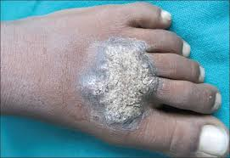
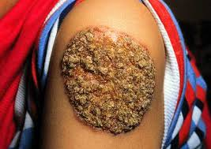
Warty TB
In exposed areas
Start as asymptomatic warty papule
Slowly develop into a warty plaque
Centre may become atrophic

Slide 31
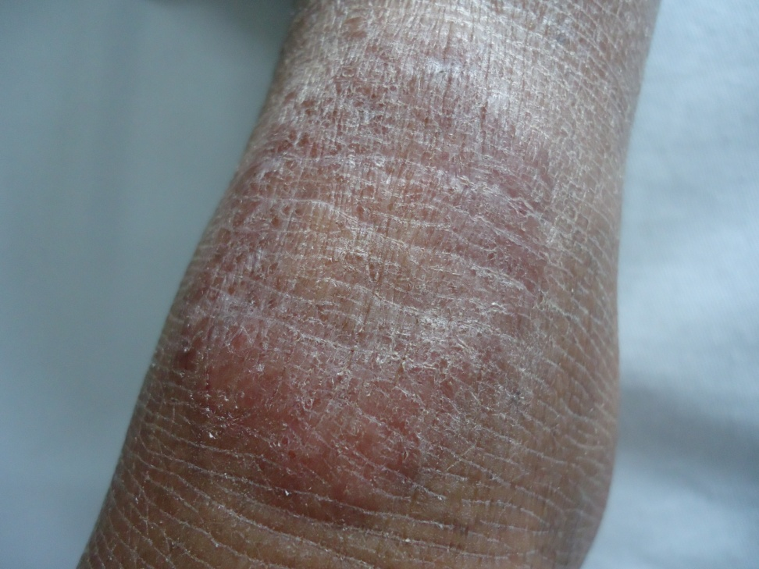
Lupus vulgaris
Long standing skin coloured/ red plaque
Slow progression
May lead to extensive scarring

Slide 32
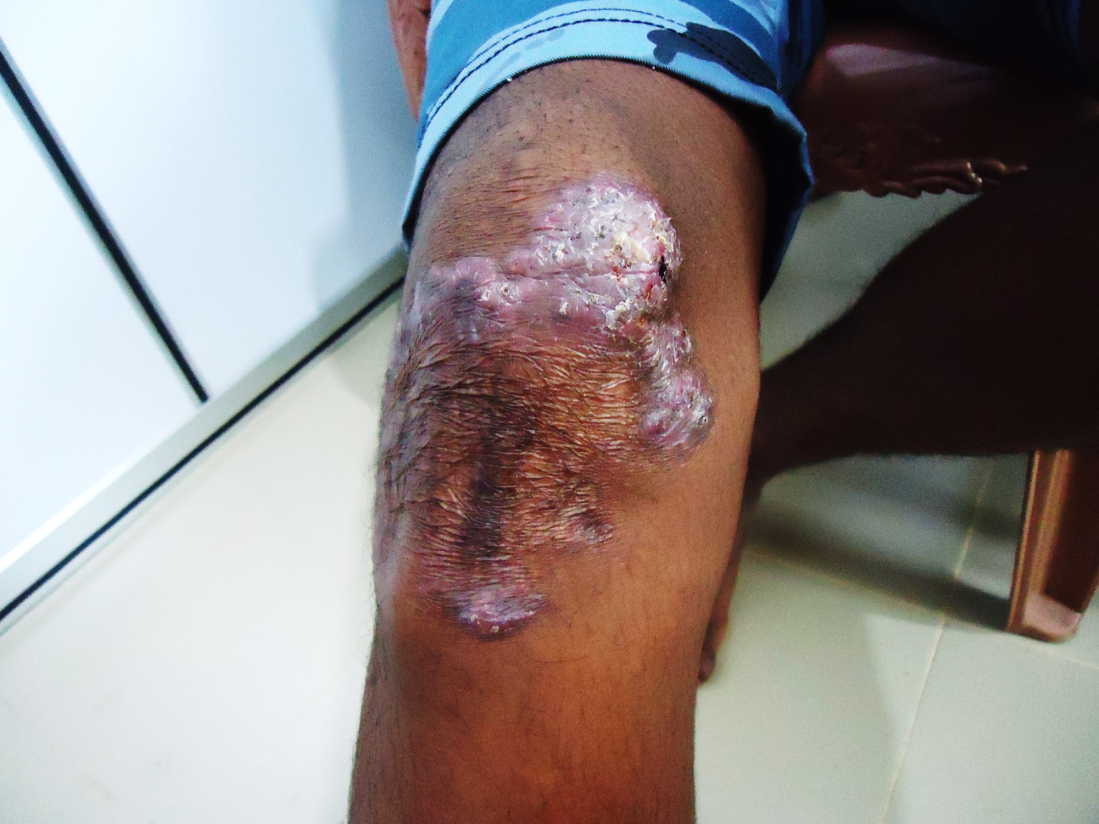
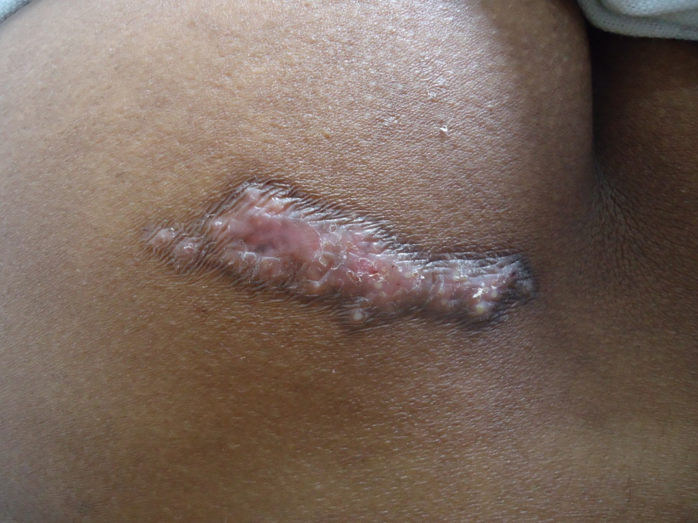
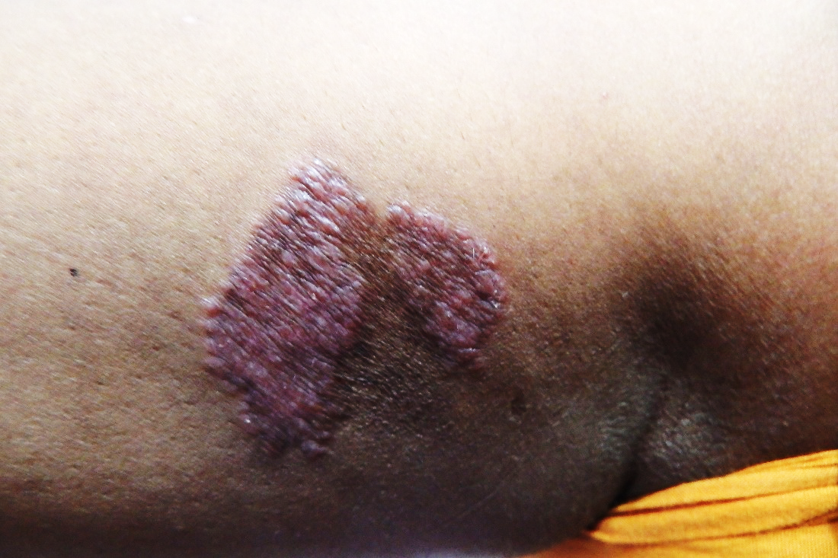

Slide 33
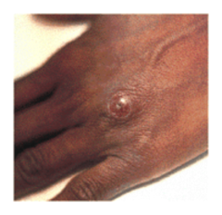
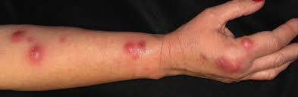
Fish tank granuloma
Due to M. marinum
In occupations associated with handling of live fish
Asymptomatic, skin coloured nodules which later develop crusting/ ulceration
May spread along lymphatics
Treatment does not include standard anti TB therapy

Slide 34
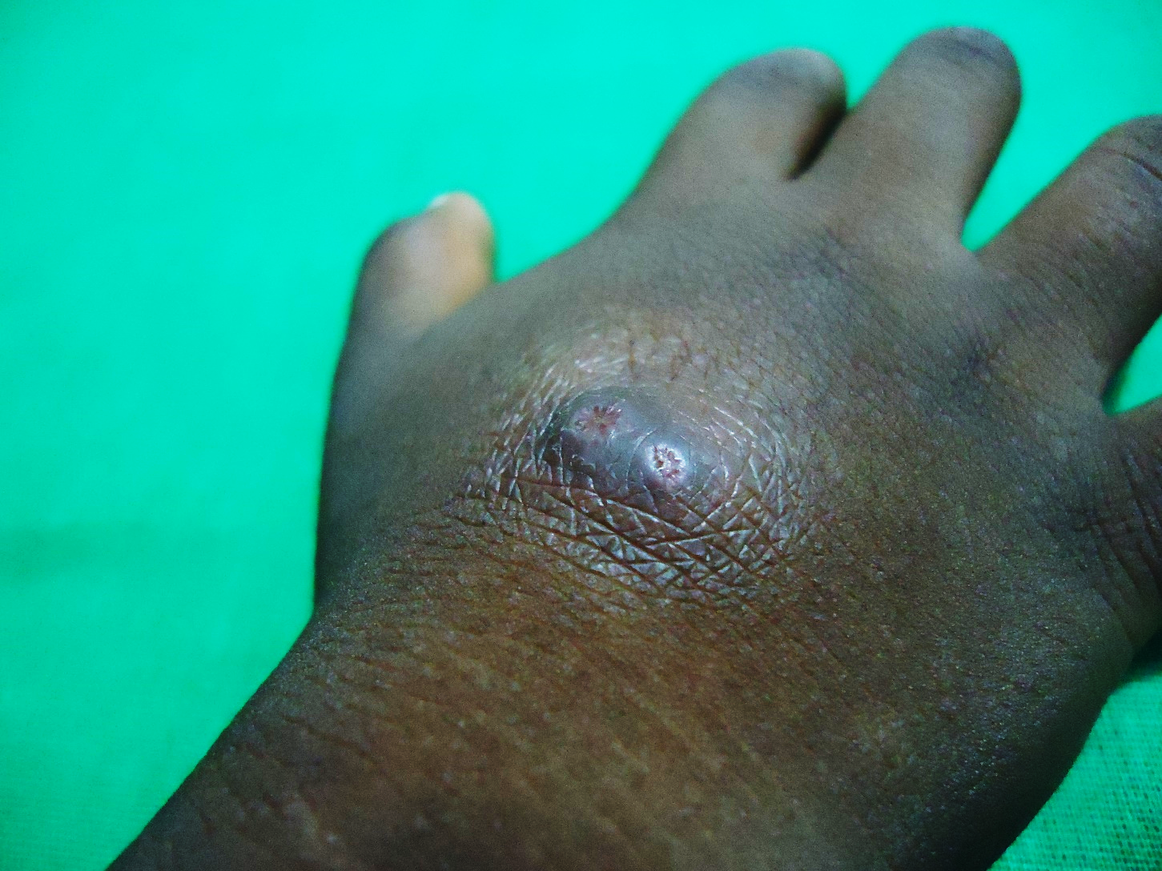
Fish tank granuloma

Slide 35
Thank you!

